Slide 1
Cyber Security and Forensics AICT014-4-2-CSF VE3
Security Concepts and Models

Slide 2
Learning Outcomes
At the end of this session, you should be able to explain
Concepts of Security
Common Terms in Security
Security Management
Risk and Risk Management
PAM and SSO
Code of Ethics

Slide 3
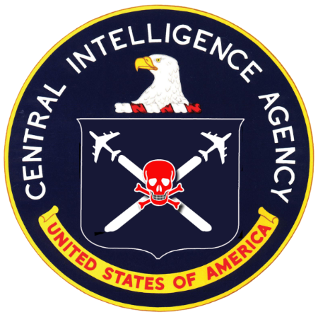
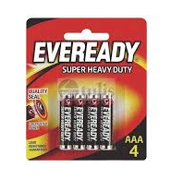
Key Terms You Must Be Able To Use
If you have mastered this topic, you should be able to use the following terms correctly in your assignments and exams:
CIA
Confidentiality
Integrity
Availability
AAA
Authentication
Authorization
Accounting

Slide 4
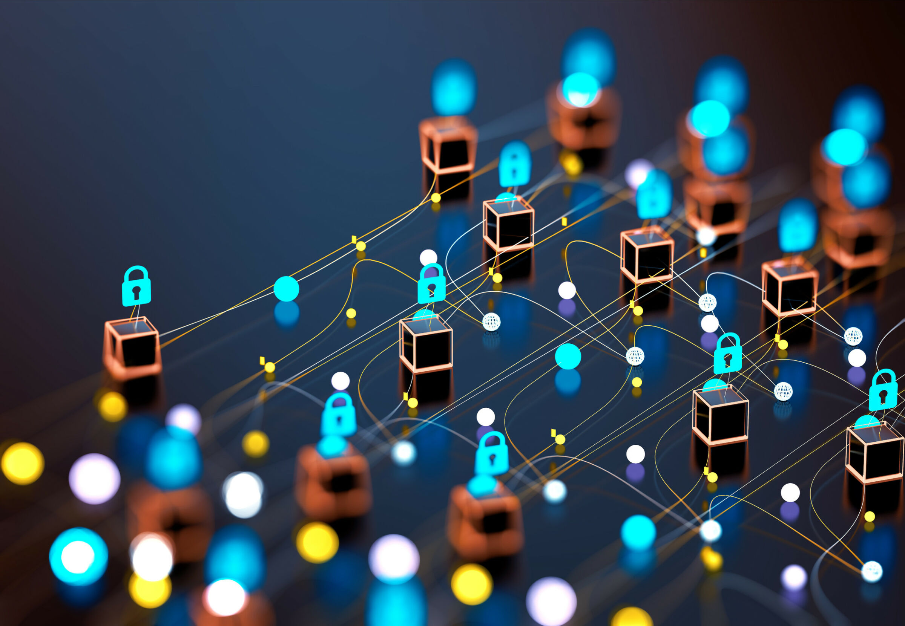
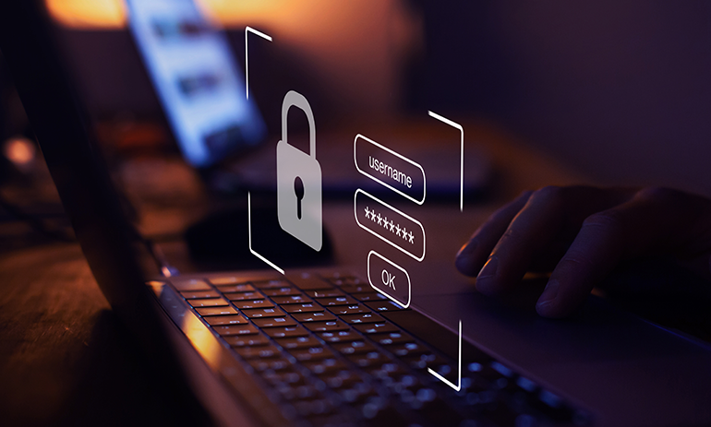
What is Security?
The state of being free from danger and not exposed to damage from accidents or attacks, or can be defined as the process for achieving that desirable state.
Digital security is the protection of your digital identity - the network or Internet equivalent of your physical identity.
Digital security includes the tools you use to secure your identity, assets and technology in the online and mobile world

Slide 5
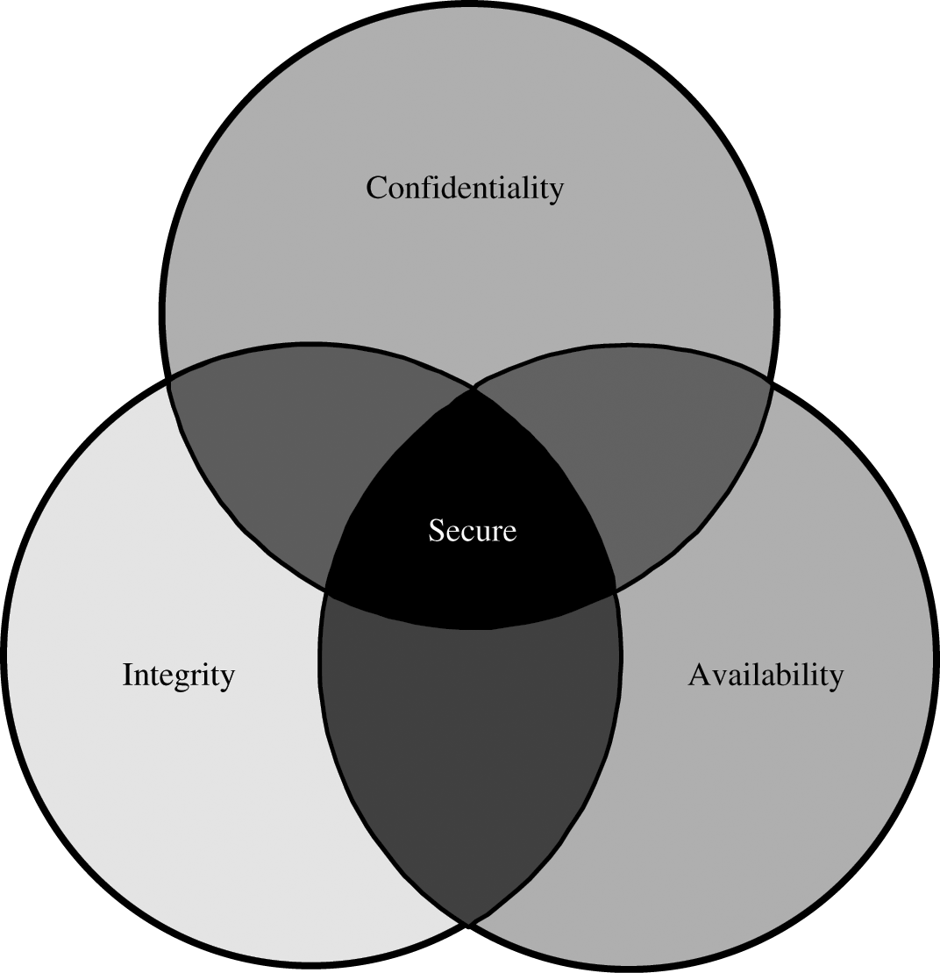
Security Objectives
Confidentiality: prevent/detect/deter improper disclosure of information.
Integrity: prevent/detect/deter improper alteration of information.
Availability: prevent/detect/deter improper denial of access to services.

Slide 6
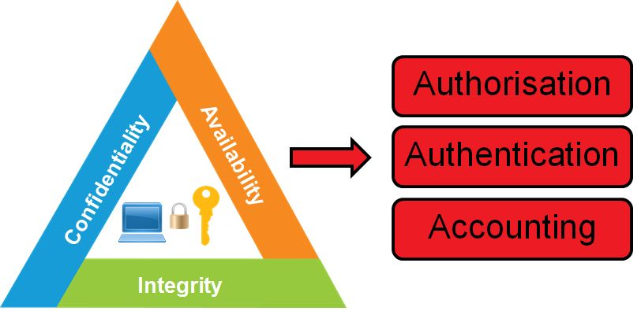
CIA and AAA
The three key principles of security control and management
A security concept for a centralized platform that performs three separate identity-based tasks.
Copyright (c) 2018 CompTIA Properties, LLC. All Rights Reserved. | CompTIA.org

Slide 7
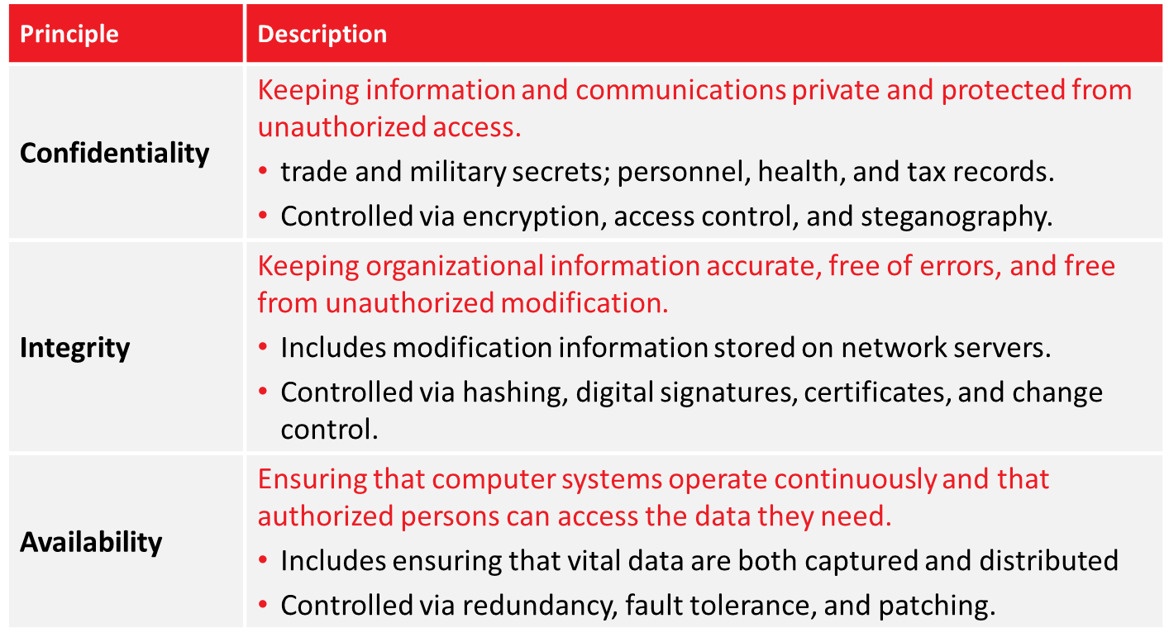
CIA Triad
Copyright (c) 2018 CompTIA Properties, LLC. All Rights Reserved. | CompTIA.org

Slide 8
AAA
Authentication: the method of identifying users, including login and password dialog, challenge and response, messaging support, and, depending on the security protocol selected, possibly encryption.
Authorization: the method for access control, including one-time authorization or authorization for each service, per-user account list and profile, user groups, and protocols
Accounting: the method for collecting and sending information used for auditing and reporting, such as user identities, start and stop times, executed commands, number of packets, and number of bytes.

Slide 9
Common Terms
Additional concerns deal more with people and transactions:
Trust
who you are and what you are authorized to do,
Non-repudiation
you can’t deny doing something you did
Auditability
I can check what you did to the data
Reliability
the system does what I want, when I want it to
Privacy
within certain limits, no one should know who I am or what I do.

Slide 10




Q&A

Slide 11
Review Questions
5 mins
WHAT IS Confidentiality, Integrity & Availability?
Which one is the most important – CIA?
Share your answer in the Teams Channel

Slide 12
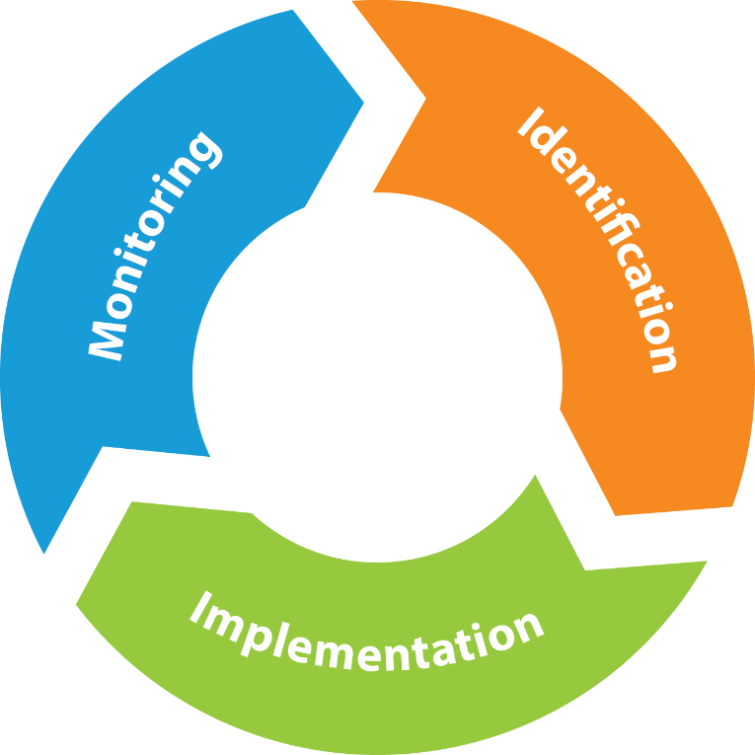
Security Management Process
Identify security controls: Detecting problems and determining how best to protect the system.
Implement security controls: Installing control mechanisms to prevent problems in a system.
Monitoring security controls: Involves detecting and solving any security issues that arise after security controls are implemented.
Copyright (c) 2018 CompTIA Properties, LLC. All Rights Reserved. | CompTIA.org

Slide 13


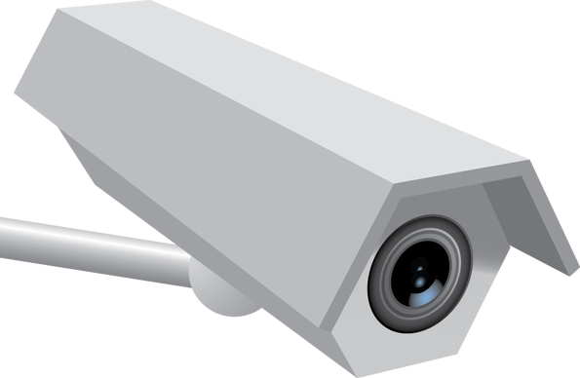


Security Controls
Countermeasures put in place to avoid, mitigate, or counteract security risks due to threats and attacks.
Solutions and activities for meeting information security objectives.
Safeguards and countermeasures, physical or logical.
Prevention Control
Detection Control
Correction Control
Copyright (c) 2018 CompTIA Properties, LLC. All Rights Reserved. | CompTIA.org

Slide 14




Risk
A concept that indicates exposure to the chance of damage or loss and signifies the likelihood of a hazard or dangerous threat.
IT risk is associated with system, power, network, and physical losses.
Can also affect people, practices, and processes.
Data in all forms must be protected.
Organizations must take risk into account when information security is designed and implemented.
Likelihood: Rare
Damage: Moderate
Disgruntled Former Employees
Threat of Improper Access

Slide 15
Vulnerabilities
Any condition that leaves a device open to harm.
Improperly configured or installed hardware or software
Delays in applying and testing software and firmware patches
Untested software or firmware patches
Bugs in software or OSs
Misusing software or communication protocols
Poorly designed networks
Poor physical security
Insecure passwords
Design flaws in software or OSs
Unchecked user input
Copyright (c) 2018 CompTIA Properties, LLC. All Rights Reserved. | CompTIA.org

Slide 16
Operations Vulnerabilities
Untrained users
Human element is largest target.
Users not equipped to spot social engineering or practice good computer security habits.
Lack of planning for critical business processes
Without EOL processes, obsolete systems may be vulnerable.
Lack of vendor support makes fixing issues more difficult.
Embedded systems may be difficult to understand.
System sprawl (unmanaged system)
Difficult for limited personnel to oversee large number of systems.
Inability to manage these systems can lead to compromise.
Undocumented assets are difficult to manage consistently.
Copyright (c) 2018 CompTIA Properties, LLC. All Rights Reserved. | CompTIA.org

Slide 17











Threats
Any event or action that could potentially cause damage to an asset.
Intentional or unintentional
Information Security Threats
Changes to Information
Interruption of Services
Interruption of Access
Damage to Hardware
Damage to Facilities
Copyright (c) 2018 CompTIA Properties, LLC. All Rights Reserved. | CompTIA.org

Slide 18




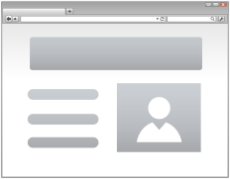
Attacks
A technique used to exploit a vulnerability in an application or physical computer system without the authorization to do so.
Physical Security Attacks
Software-Based Attacks
Social Engineering Attacks
Web Application-Based Attacks
Network-Based Attacks
Copyright (c) 2018 CompTIA Properties, LLC. All Rights Reserved. | CompTIA.org

Slide 19
Risk Management
Risk Management refers to the practice of identifying potential risks in advance, analyzing them and taking precautionary steps to reduce the risk
Risk can be determined as a function of the probability of a threat exploiting a vulnerability, and the probable value of damage to assets
Risk =
f (Threat, Vulnerability, Value)

Slide 20
Q&A

Slide 21
Review Questions
5 mins
What is Security Management Process?
What is Risk Management?
Share your answer in Teams channel

Slide 22








PAM and SSO
Privilege Access Management: The use of authentication and authorization mechanisms to provide centralized or decentralized administration of user and group access control.
Single Sign-On: An aspect of privilege management that provides users with one-time authentication to multiple resources, servers, or sites.
Accounting/Auditing
Authorization
Access Control
Administrator
Authentication
Access Control <=> Availability
Copyright (c) 2018 CompTIA Properties, LLC. All Rights Reserved. | CompTIA.org

Slide 23

Principle of Least Privilege
Users and software should have the minimal level of access that is necessary for them to perform the duties required of them.
Applies access to facilities, computer hardware, software, and information.
Assign only the level of access required to perform the necessary tasks.
Perform their jobs with fewer privileges
User 1
User 4
Perform their jobs with more privileges
User 2
User 3
Data Entry Clerks
Financial Coordinators

Slide 24
Further Reading
https://www.keepersecurity.com/assets/pdf/PAM-vs-SSO-vs-PasswordManager.pdf
Time Allocated: 10 minutes
Output: Share your findings in PowerPoint (1 slide only)

Slide 25
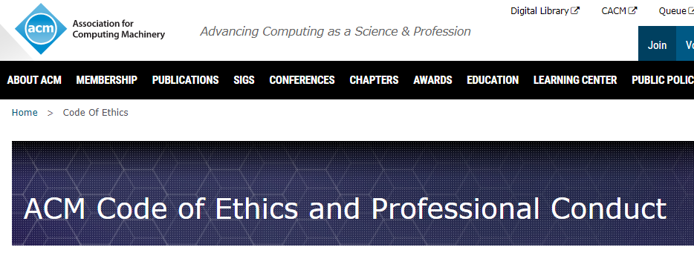
Code of Ethics
www.acm.org/about/code-of-ethics
*Moral principles that govern your behavior (action)

Slide 26
Code of Ethics
The actions of computing professionals change the world.
To act responsibly, they should reflect upon the wider impacts of their work, consistently supporting the public good.
The ACM Code of Ethics and Professional Conduct expresses the conscience of the profession.

Slide 27
Code of Ethics
The Code is concerned with how fundamental ethical principles apply to a computing professional's conduct.
The Code is not an algorithm for solving ethical problems; rather it serves as a basis for ethical decision-making.
When thinking through an issue, questions can best be answered by thoughtful consideration of the fundamental ethical principles
Multiple principles should be considered, and different principles will have different relevance to the issue.

Slide 28
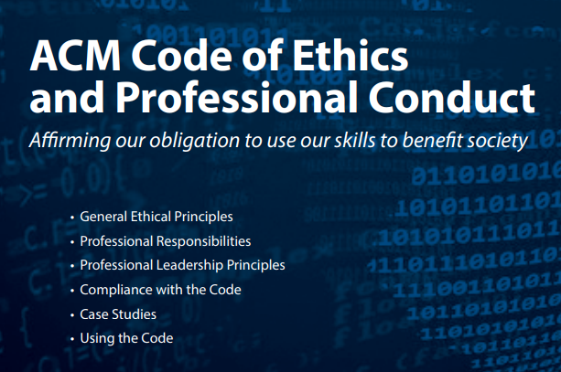

Slide 29
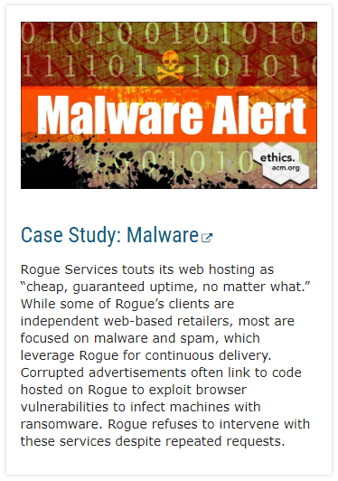
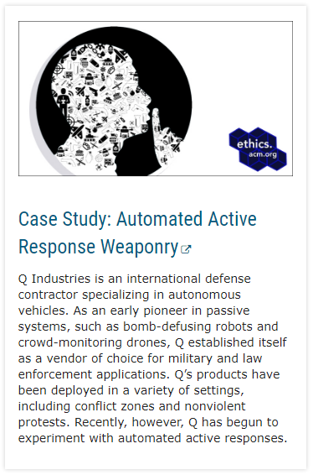
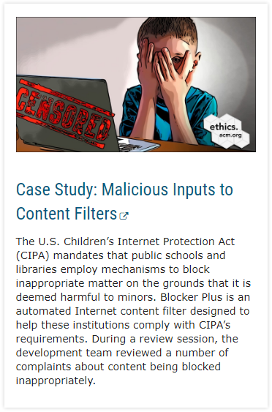
Further Reading
https://www.acm.org/code-of-ethics/case-studies

Slide 30

QUIZIZZ
https://quizizz.com/join

Slide 31
Summary of Main Teaching Points
Concepts of Security
Common Terms in Security
Security Management
Risk and Risk Management
PAM and SSO
Code of Ethics

Slide 32
Q&A

